Slide 1
Document ingestion

Slide 2

Recall the basic indexing pipeline
Documents to
be indexed
Friends, Romans, countrymen.
Tokenizer
Token stream
Friends
Romans
Countrymen
Linguistic modules
Modified tokens
friend
roman
countryman
Indexer
friend
2
4
roman
1
2
Inverted index
countryman
13
16
Notes:
Circle documents

Slide 3
Parsing a document
Sec. 2.1
What format is it in?
  pdf/word/excel/html?
What language is it in?
What character set is in use?
  (CP1252, UTF-8, …)
Each of these is a classification problem, which we will study later in the course.
But these tasks are often done heuristically …
Notes:
A heuristic technique, often called simply a heuristic, is any approach to problem solving or self-discovery that employs a practical method, not guaranteed to be optimal, perfect, or rational, but instead sufficient for reaching an immediate goal.

Slide 4
Complications: Format/language
Sec. 2.1
Documents being indexed can include docs from many different languages
  A single index may contain terms from many languages.
Sometimes a document or its components can contain multiple languages/formats
  French email with a German pdf attachment.
  French email quote clauses from an English-language contract
There are commercial and open source libraries that can handle a lot of this stuff
Notes:
Nontrivial issues. Requires some design decisions.

Slide 5
Complications: What is a document?
Sec. 2.1
We return from our query “documents” but there are often interesting questions of grain size:
What is a unit document?
  A file?
  An email? (Perhaps one of many in a single mbox file)
    What about an email with 5 attachments?
  A group of files (e.g., PPT or LaTeX split over HTML pages)
Notes:
Nontrivial issues. Requires some design decisions.

Slide 6
Tokens

Slide 7
Tokenization
Sec. 2.2.1
Input: “Friends, Romans and Countrymen”
Output: Tokens
  Friends
  Romans
  Countrymen
A token is an instance of a sequence of characters
Each such token is now a candidate for an index entry, after further processing
  Described below
But what are valid tokens to consider?

Slide 8
Tokenization
Sec. 2.2.1
Issues in tokenization:
  Finland’s capital →
  Finland AND s? Finlands? Finland’s?
  Hewlett-Packard → Hewlett and Packard as two tokens?
    state-of-the-art: break up hyphenated sequence.
    co-education
    lowercase, lower-case, lower case ?
    It can be effective to get the user to put in possible hyphens
  San Francisco: one token or two?
    How do you decide it is one token?

Slide 9
Numbers
Sec. 2.2.1
3/20/91 Mar. 12, 1991 20/3/91
55 B.C.
B-52
My PGP key is 324a3df234cb23e
(800) 234-2333
  Often have embedded spaces
  Older IR systems may not index numbers
    But often very useful: think about things like looking up error codes/stacktraces on the web
    (One answer is using n-grams: IIR ch. 3)
  Will often index “meta-data” separately
    Creation date, format, etc.

Slide 10
Tokenization: language issues
Sec. 2.2.1
French
  L'ensemble → one token or two?
    L ? L’ ? Le ?
    Want l’ensemble to match with un ensemble
      Until at least 2003, it didn’t on Google
        Internationalization!
German noun compounds are not segmented
  Lebensversicherungsgesellschaftsangestellter
  ‘life insurance company employee’
  German retrieval systems benefit greatly from a compound splitter module
      Can give a 15% performance boost for German

Slide 11
Tokenization: language issues
Sec. 2.2.1
Chinese and Japanese have no spaces between words:
  莎拉波娃现在居住在美国东南部的佛罗里达。
  Not always guaranteed a unique tokenization
Further complicated in Japanese, with multiple alphabets intermingled
  Dates/amounts in multiple formats
  フォーチュン500社は情報不足のため時間あた$500K(約6,000万円)
Katakana
Hiragana
Kanji
Romaji
End-user can express query entirely in hiragana!

Slide 12
Tokenization: language issues
Sec. 2.2.1
Arabic is basically written right to left, but with certain items like numbers written left to right
Words are separated, but letter forms within a word form complex ligatures
← → ← → ← start
‘Algeria achieved its independence in 1962 after 132 years of French occupation.’
With Unicode, the surface presentation is complex, but the stored form is straightforward
استقلت الجزائر في عام 1962 بعد 132 عاما من الاحتلال الفرنسي

Slide 13
Terms
The things indexed in an IR system

Slide 14
Stop words
Sec. 2.2.2
With a stop list, you entirely exclude the commonest words from the dictionary.
Intuition:
  They have little semantic content: the, a, and, to, be
  There are a lot of them: ~30% of postings for the top 30 words
But the trend is away from doing this:
  Good compression techniques (IIR 5) means the space for including stop words in a system is very small
  Good query optimization techniques (IIR 7) mean you pay little for including stop words at query time.
  You need them for:
    Phrase queries: “King of Denmark”
    Various song titles, etc.: “Let it Be”, “To Be or Not to Be”
    “Relational” queries: “flights to London”
Notes:
Nevertheless: “Google ignores common words and characters such as where, the, how, and other digits and letters which slow down your search without improving the results.” (Though you can explicitly ask for them to remain.)

Slide 15
Normalization to terms
Sec. 2.2.3
We may need to “normalize” words in indexed text as well as query words into the same form
  We want to match U.S.A. and USA
Result is terms: a term is a (normalized) word type, which is an entry in our IR system dictionary
We most commonly implicitly define equivalence classes of terms by, e.g.,
  deleting periods to form a term
    U.S.A., USA ⎝ USA(
  deleting hyphens to form a term
    anti-discriminatory, antidiscriminatory ⎝ antidiscriminatory(

Slide 16
Normalization: other languages
Sec. 2.2.3
Accents: e.g., French résumé vs. resume.
Umlauts: e.g., German: Tuebingen vs. Tübingen
  Should be equivalent
Most important criterion:
  How are your users like to write their queries for these words?
Even in languages that standardly have accents, users often may not type them
  Often best to normalize to a de-accented term
    Tuebingen, Tübingen, Tubingen ⎝ Tubingen

Slide 17
Normalization: other languages
Sec. 2.2.3
Normalization of things like date forms
  7月30日 vs. 7/30
  Japanese use of kana vs. Chinese characters
Tokenization and normalization may depend on the language and so is intertwined with language detection
Crucial: Need to “normalize” indexed text as well as query terms identically
Is this
German “mit”?
Morgen will ich in MIT …

Slide 18
Case folding
Sec. 2.2.3
Reduce all letters to lower case
  exception: upper case in mid-sentence?
    e.g., General Motors
    Fed vs. fed
    SAIL vs. sail
  Often best to lower case everything, since users will use lowercase regardless of ‘correct’ capitalization…
Longstanding Google example: [fixed in 2011…]
  Query C.A.T.
  #1 result is for “cats” (well, Lolcats) not Caterpillar Inc.
Notes:
Caterpillar Inc. is an American corporation which designs, develops, engineers, manufactures, markets and sells machinery, engines, financial products and insurance to customers via a worldwide dealer network.

Slide 19
Normalization to terms
Sec. 2.2.3
An alternative to equivalence classing is to do asymmetric expansion
An example of where this may be useful
  Enter: window Search: window, windows
  Enter: windows Search: Windows, windows, window
  Enter: Windows Search: Windows
Potentially more powerful, but less efficient
Notes:
Why not the reverse?

Slide 20
Thesauri and soundex
Do we handle synonyms and homonyms?
  E.g., by hand-constructed equivalence classes
    car = automobile color = colour
  We can rewrite to form equivalence-class terms
    When the document contains automobile, index it under car-automobile (and vice-versa)
  Or we can expand a query
    When the query contains automobile, look under car as well
What about spelling mistakes?
  One approach is Soundex, which forms equivalence classes of words based on phonetic heuristics
More in IIR 3 and IIR 9
Notes:
Thesauri:a book that lists words in groups of synonyms and related concepts.
Soundex:a phonetic coding system intended to suppress spelling variations, used especially to encode surnames for the linkage of medical and other records.

Slide 21
Stemming and Lemmatization

Slide 22
Lemmatization
Sec. 2.2.4
Reduce inflectional/variant forms to the base form
E.g.,
  am, are, is → be
  car, cars, car's, cars' → car
the boy's cars are different colors → the boy car be different color
Lemmatization implies doing “proper” reduction to dictionary headword form

Slide 23
Stemming
Sec. 2.2.4
Reduce terms to their “roots” before indexing
“Stemming” suggests crude affix chopping
  language dependent
  e.g., automate(s), automatic, automation all reduced to automat.
for example compressed
and compression are both
accepted as equivalent to
compress.
for exampl compress and
compress ar both accept
as equival to compress

Slide 24
Porter’s algorithm
Sec. 2.2.4
Commonest algorithm for stemming English
  Results suggest it’s at least as good as other stemming options
Conventions + 5 phases of reductions
  phases applied sequentially
  each phase consists of a set of commands
  sample convention: Of the rules in a compound command, select the one that applies to the longest suffix.

Slide 25
Typical rules in Porter
Sec. 2.2.4
sses → ss
ies → i
ational → ate
tional → tion
Weight of word sensitive rules
(m>1) EMENT →
    replacement → replac
    cement → cement

Slide 26
Other stemmers
Sec. 2.2.4
Other stemmers exist:
  Lovins stemmer
    http://www.comp.lancs.ac.uk/computing/research/stemming/general/lovins.htm
    Single-pass, longest suffix removal (about 250 rules)
  Paice/Husk stemmer
  Snowball
Full morphological analysis (lemmatization)
  At most modest benefits for retrieval

Slide 27
Language-specificity
Sec. 2.2.4
The above methods embody transformations that are
  Language-specific, and often
  Application-specific
These are “plug-in” addenda to the indexing process
Both open source and commercial plug-ins are available for handling these

Slide 28
Does stemming help?
Sec. 2.2.4
English: very mixed results. Helps recall for some queries but harms precision on others
  E.g., operative (dentistry) ⇒ oper
Definitely useful for Spanish, German, Finnish, …
  30% performance gains for Finnish!

Slide 29
Faster postings merges:
Skip pointers/Skip lists

Slide 30
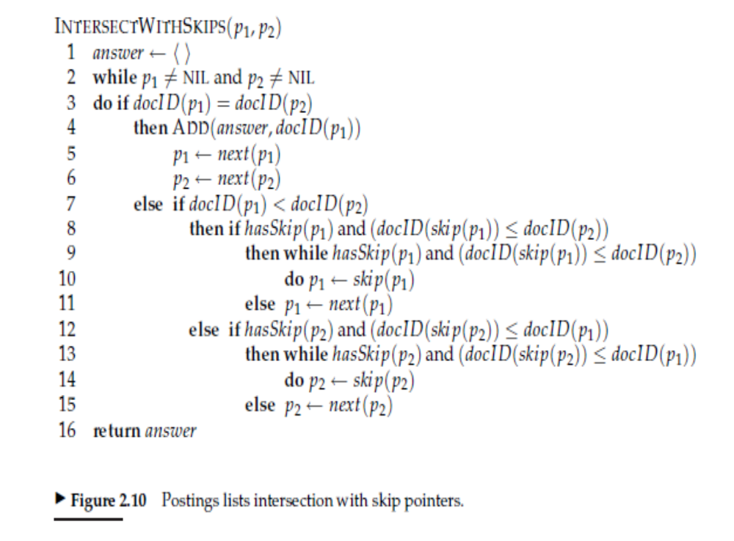


Slide 31
Recall basic merge
Sec. 2.3
Walk through the two postings simultaneously, in time linear in the total number of postings entries
2
4
8
41
48
64
128
Brutus
2
8
1
2
3
8
11
17
21
31
Caesar
If the list lengths are m and n, the merge takes O(m+n)
operations.
Can we do better?
Yes (if the index isn’t changing too fast).

Slide 32
Augment postings with skip pointers (at indexing time)
Sec. 2.3
41
128
2
4
8
41
48
64
128
11
31
1
2
3
8
11
17
21
31
Why?
To skip postings that will not figure in the search results.
How?
Where do we place skip pointers?

Slide 33
Query processing with skip pointers
Sec. 2.3
41
128
2
4
8
41
48
64
128
11
31
1
2
3
8
11
17
21
31
Suppose we’ve stepped through the lists until we process 8 on each list. We match it and advance.
We then have 41 and 11 on the lower. 11 is smaller.
But the skip successor of 11 on the lower list is 31, so
we can skip ahead past the intervening postings.

Slide 34
Where do we place skips?
Sec. 2.3
Tradeoff:
  More skips → shorter skip spans ⇒ more likely to skip. But lots of comparisons to skip pointers.
  Fewer skips → few pointer comparison, but then long skip spans ⇒ few successful skips.

Slide 35
Placing skips
Sec. 2.3
Simple heuristic: for postings of length L, use √L evenly-spaced skip pointers [Moffat and Zobel 1996]
This ignores the distribution of query terms.
Easy if the index is relatively static; harder if L keeps changing because of updates.
This definitely used to help; with modern hardware it may not unless you’re memory-based [Bahle et al. 2002]
  The I/O cost of loading a bigger postings list can outweigh the gains from quicker in memory merging!

Slide 36
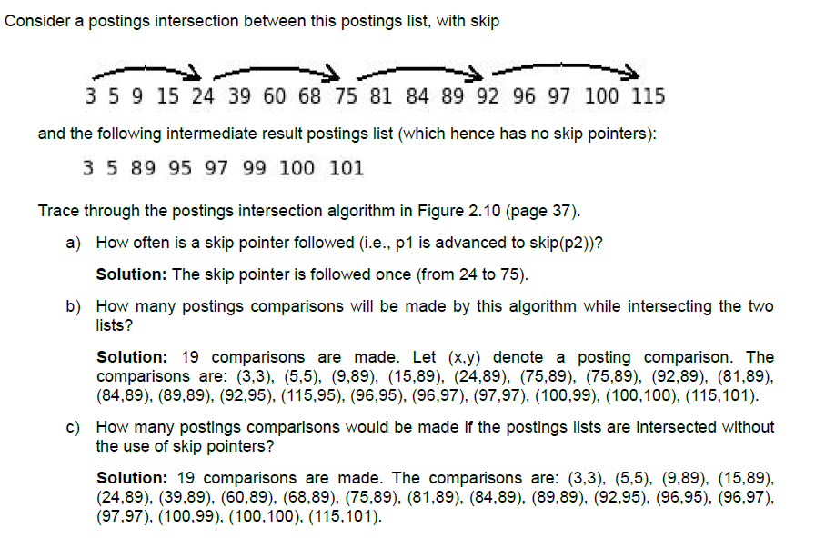
Quiz

